Slide 1

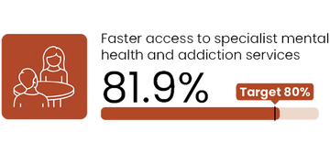
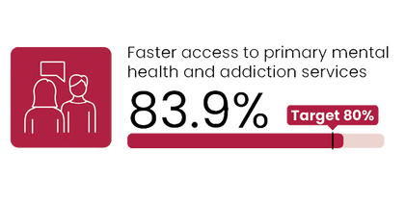
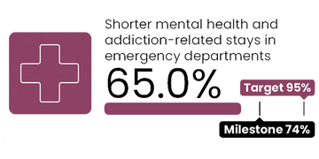
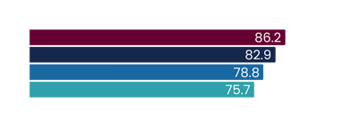
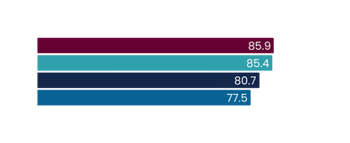
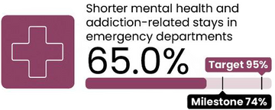
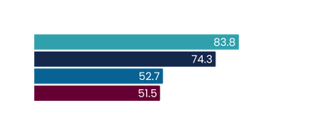
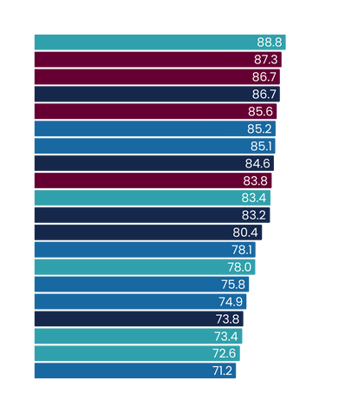
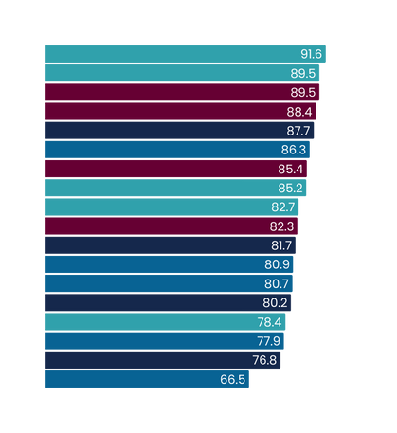
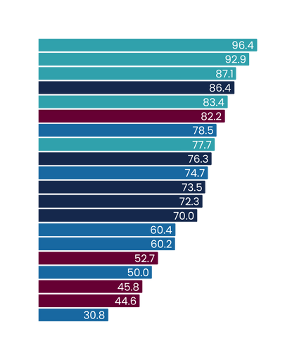
Results by region
Mental health and addiction targets
Q2 2024/25
Oct - Dec 2024
Faster access to specialist mental health and addiction services
Faster access to primary mental health and addiction services
Shorter mental health and addiction-related stays in EDs
2030 target = 80%
2030 target = 80%
2030 target = 95%
This measure presents the percentage of people accessing specialist MH&A services seen within three weeks of referral.
This measure presents the percentage of people accessing primary MH&A services through the Access and Choice programme within one week.
This measure presents the percentage of mental health related ED attendances that were admitted, discharged or transferred from an ED within six hours as a proportion of all mental health related attendances.
National result
National result
National result
Results by region
Target
Results by region
Target
Northern
Te Manawa Taki
Central
Te Waipounamu
Northern
Te Waipounamu
Te Manawa Taki
Central
Milestone
Target
Te Waipounamu
Te Manawa Taki
Central
Northern
Results by district
Target
Results by district
Target
West Coast
Auckland
Counties Manukau
Taranaki
Waitematā
MidCentral
Hawkes Bay
Waikato
Northland
South Canterbury
Lakes
Bay of Plenty
Whanganui
Southern
Wairarapa
Hutt Valley
Tairāwhiti
Nelson Marlborough
Canterbury
Capital and Coast
Southern
West Coast
Northland
Auckland
Waikato
Whanganui
Counties Manukau
South Canterbury
Canterbury
Waitematā
Bay of Plenty
Wairarapa
Hawke's Bay
Lakes
Nelson Marlborough
Capital and Coast
Taranaki
Hutt Valley
Tairāwhiti
MidCentral
Results by district
Milestone
Target
South Canterbury
West Coast
Southern
Tairāwhiti
Canterbury
Northland
Whanganui
Nelson Marlborough
Bay of Plenty
Hawke's Bay
Lakes
Waikato
Taranaki
Wairarapa
MidCentral
Auckland
Hutt Valley
Counties Manukau
Waitematā
Capital and Coast
UNAVAILABLE (see caveats)
UNAVAILABLE (see caveats)
All figures displayed are percentages.
NB: Factsheets contain figures used in Quarter 2 report. Health target data changes over time and there may be slight discrepancies between reports dependent on their time of publication.

Slide 2
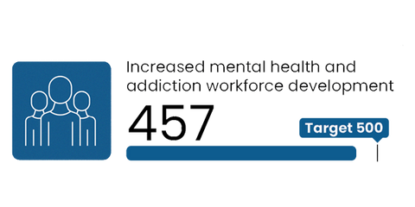
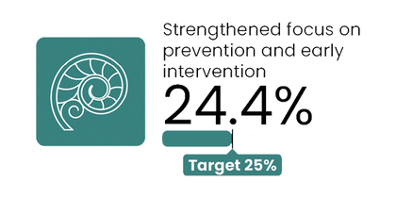
Mental health and addiction targets
Q2 2024/25
Oct - Dec 2024
Increased mental health and addiction workforce development
Strengthened focus on prevention and early intervention
Shorter mental health and addiction-related stays in EDs
Target = 500 more trained yearly
2030 target = 25%
Q2 overview
National result
National result
The national Q2 result is currently sitting at 65 per cent, well short of the 74 per cent milestone and 95 per cent target.
South Canterbury is currently leading the way, at 96.4 percent, with West Coast not far behind at 92.9 percent.
In all regions, a strong operational drive to improve performance must continue.
This measure presents the number of mental health and addiction professionals trained each year in New Zealand.
This measure presents the proportion of mental health and addiction ringfenced investment allocated to prevention and early intervention.
Q2 overview
Q2 overview
This result is the annual budgeted investment; it does not represent the proportion of the mental health and addiction ringfence that has been spent during the quarter.
Work is underway to increase investment in prevention and early intervention services, including a request for proposal for a mental wellbeing promotion campaign, and increased investment in maternal mental health services and infant, child and youth services in districts with the lowest levels of investment.
Faster access to primary mental health and addiction services
In the 2024 academic (calendar) year, 457 people commenced training in the identified professions.
The next result will be for semester 1 of the 2025 academic year, reported in quarter three.
The following initiatives are in place to support improvements:
  Development of a contract with the New Zealand Psychology Board to commence scoping and establishing competencies for a new associate psychology role and procurement for the development of the training programme with tertiary providers.
  Contracting for clinical psychology interns, with 56.5 full time equivalents contracted as at the end of the quarter for 2024/25. This is an increase from the 50 available intern positions in 2024.
  Working with the Royal Australian and New Zealand College of Psychiatrists to explore improved central co-ordination of the recruitment of psychiatry registrars.
  There is work underway to explore the use of alternative workforces regionally.
Q2 overview
At a national level, results show us sitting above the target, at 83.9 per cent.
When broken down by region, Northern, Te Waipounamu and Te Manawa Taki are all sitting above 80 per cent.
Central | Te Ikaroa saw a decline this quarter and is currently sitting just below the target at 77.5 per cent.
In most districts, more than 80 per cent of people are accessing services within one week.
Faster access to specialist mental health and addiction services
Q2 overview
Whilst these results are promising, there is more work to do.
At a national level, results show us sitting above the target, at 81.9 per cent. This is a 1.5 per cent increase compared to Q1.
When broken down by region, Northern and Te Manawa Taki are both sitting above 80 per cent.
Central | Te Ikaroa is currently sitting just shy of the target at 78.8 per cent.
NB: Factsheets contain figures used in Quarter 2 report. Health target data changes over time and there may be slight discrepancies between reports dependent on their time of publication.

