Slide 1

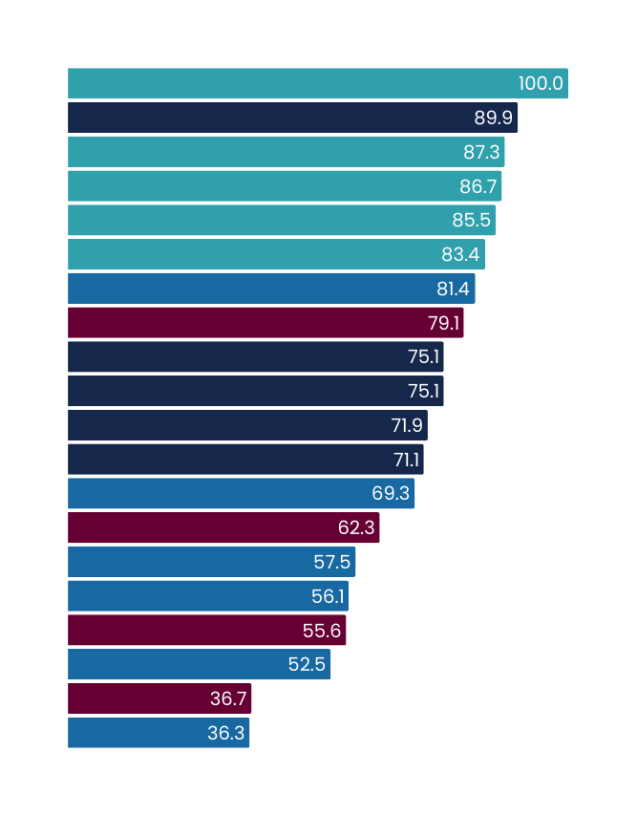
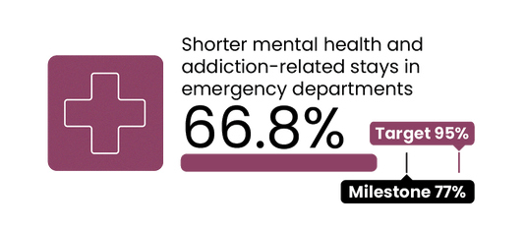
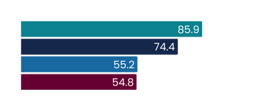
Q1 2025/26
July - September 2025
Shorter mental health and addiction-related stays in EDs
2025/26 milestone = 77% | 2030 target = 95%
This measure reports the percentage of mental health and addiction-related ED attendances that were admitted, discharged or transferred from an ED within six hours, as a proportion of all mental health and addiction-related attendances.
National result
Results by region
Milestone
Target
Results by district
Milestone
Target
Te Waipounamu
Te Manawa Taki
Central | Te Ikaroa
Northern
West Coast
Tairāwhiti
Southern
South Canterbury
Canterbury
Nelson Marlborough
Whanganui
Northland
Lakes
Waikato
Taranaki
Bay of Plenty
Hawke’s Bay
Auckland
MidCentral
Wairarapa
Waitematā
Hutt Valley
Counties Manukau
Capital and Coast
Milestone: 30 June 2026
Q1 results compared with Q1 last year
 | Q1 2024/25 | Q1 2025/26 | % point change
Shorter mental health and addiction-related stays in ED <6hrs | 63.5% | 66.8% | 3.3%
Q1 overview
Performance has dropped between Q4 (autumn) and Q1 (winter) but remains higher than the same time last year signalling a continuous trajectory of improvement. Q1 performance is in line with historical seasonal variance in service demand.
We have committed to opening six crisis cafes in 2025/26, across all four Health NZ regions, with the aim of reducing demand on EDs by providing more mental health and addictions support options closer to home. The first crisis cafe opened in Whanganui this quarter. We are on track to open two cafes, one in Auckland and one Taranaki, in quarter two.
All districts in Te Waipounamu are meeting the 2025/26 milestone, attributed to close proximity of mental health services to EDs, early alert systems for mental health support needs, and capacity to respond promptly. Crisis café development is progressing in Christchurch and Dunedin, which will support further improvements in performance.
Recent improvements in our Te Manawa Taki region include strengthened ED triage and crisis collaboration in Waikato and implementation of electronic clinical documentation (to support faster decision making and improve patient flow) in Bay of Plenty. Districts are also reviewing patient pathways and strengthening on call expectations to improve performance in this target.
Whanganui performance dropped during quarter one when compared to quarter four, but it is still meeting the milestone. The district is continuing to review all mental health ED presentations weekly to optimise processes. Whanganui ED has also introduced a dedicated space where people requiring a mental health assessment can wait when they no longer need to be in ED, to improve overall hospital flow. Other Central region districts are wanting to replicate this model. Work is underway to open a 15-bed extended care service (for all patients, not just mental health) at Manor Park (Hutt Valley district) in November to support community-based recovery and improve hospital flow.
Peer Support in Wellington ED (Capital and Coast district) is now fully operational, working Monday to Thursday during peak hours to enhance patient experience and support. Peer Support will launch in more EDs during quarter two, in Southern, Waitematā and Bay of Plenty districts.
Northern region has completed patient journey mapping to identify delays; improvement plans are underway for metro Auckland districts, including Counties Manukau, which faces high and variable demand.
Milestone - 30 June 2026
All figures displayed are percentages.
Comparisons to historic data reflects the first published result. Data is based on point-in-time snapshots and may differ from other published statistics due to differences in timing, methodology, or data sources. See caveats.

Slide 2
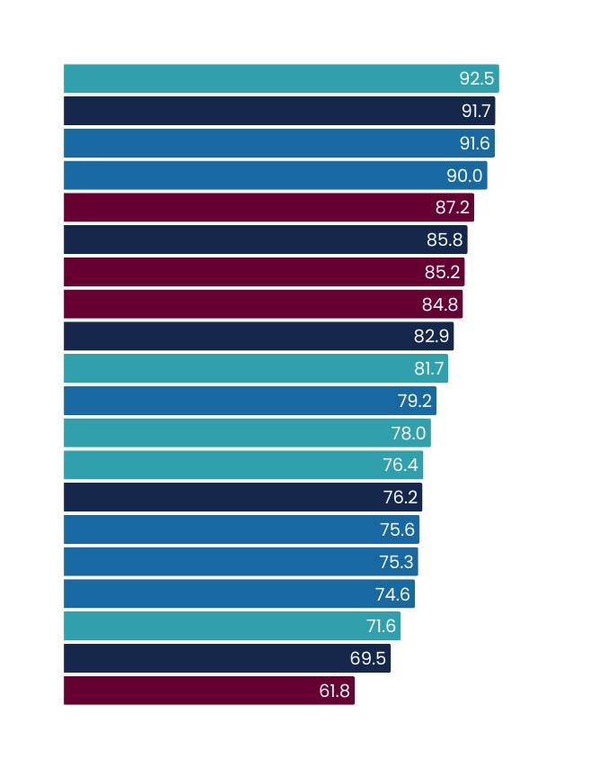
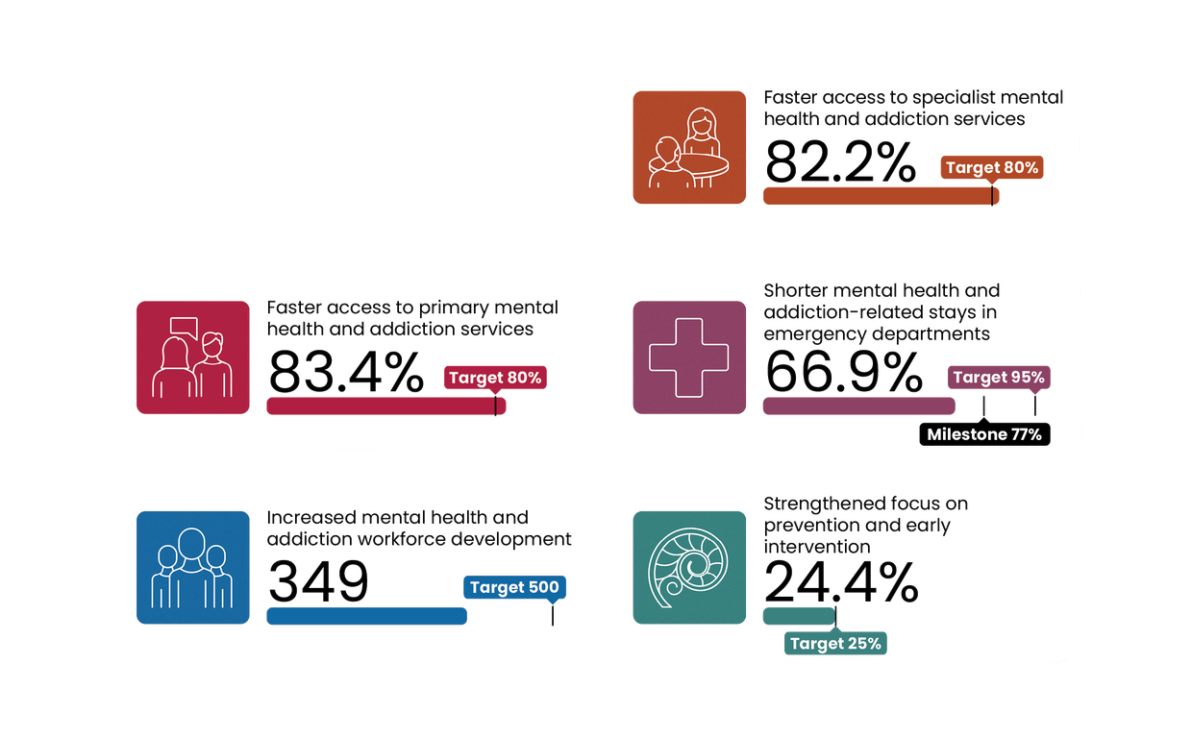
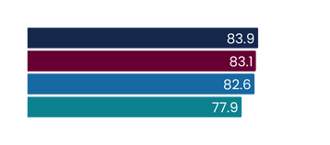
Faster access to specialist mental health and addiction services
2030 target = 80%
Q1 2025/26
July - September 2025
This measure shows the percentage of people accessing specialist mental health and addiction services seen within three weeks of referral.
National result
Results by region
Target
Results by district
Target
Te Manawa Taki
Northern
Central | Te Ikaroa
Te Waipounamu
South Canterbury
Taranaki
MidCentral
Hawke’s Bay
Counties Manukau
Waikato
Waitematā
Auckland
Bay of Plenty
West Coast
Whanganui
Canterbury
Southern
Lakes
Capital and Coast
Wairarapa
Hutt Valley
Nelson Marlborough
Tairāwhiti
Northland
Q1 results compared with Q1 last year
 | Q1 2024/25 | Q1 2025/26 | % point change
Faster access to specialist mental health and addiction services | 80.4% | 82.2% | 1.8%
Q1 overview
Te Manawa Taki continues to sustain their high performance against this target, through continued regional expansion of integrated access and flow initiatives. The region is also developing regional intake and triage criteria for its Infant Child and Adolescent Mental Health Services.
Initiatives are underway across Te Waipounamu to improve regional performance, such as nurse led clinics in Canterbury. A change to triage processes for Nelson Marlborough (also being trialled in high-performing South Canterbury) is showing positive results.
In Northern, a deeper analysis is underway to understand variations in district performance against this target, particularly for under-25-year-olds in Counties Manukau and Waitematā. Importantly, Northland is currently experiencing data integrity issues due to the transition to the MyWai system. Prior to this change, performance consistently met or exceeded the 80% target. Northland reports no changes to its models of care or service delivery approaches suggesting that, despite the reported result, actual timeliness of referrals likely remains high. System issues are expected to be resolved by December, so we hope to report more accurate data in quarter two or three.
All figures displayed are percentages.
Comparisons to historic data reflects the first published result. Data is based on point-in-time snapshots and may differ from other published statistics due to differences in timing, methodology, or data sources. See caveats.

Slide 3
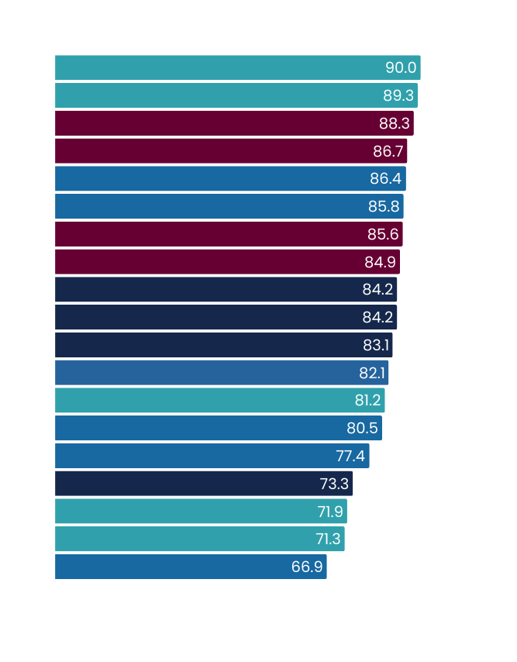
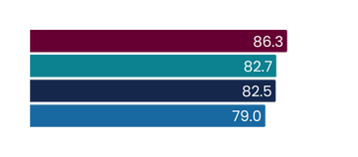
Q1 2025/26
July - September 2025
Faster access to primary mental health and addiction services
2030 target = 80%
This measure shows the percentage of people accessing primary mental health and addiction services through the Access and Choice programme within one week.
National result
Results by region
Target
Results by district
Target
Northern
Te Waipounamu
Te Manawa Taki
Central | Te Ikaroa
West Coast
Southern
Auckland
Northland
Wairarapa
Whanganui
Waitematā
Counties Manukau
Lakes
Bay of Plenty
Waikato
Hawke’s Bay
Canterbury
Capital and Coast
MidCentral
Taranaki
South Canterbury
Nelson Marlborough
Hutt Valley
Tairāwhiti
Q1 results compared with Q1 last year
 | Q1 2024/25 | Q1 2025/26 | % point change
Faster access to primary mental health and addiction services | 80.8% | 83.4% | 2.6%
Q1 overview
Te Manawa Taki region is implementing a district-focused workplan to improve performance while continuing to maintain timely access. Planning priorities include data quality, flexible service models, Alcohol and Other Drug service support, workforce development, and embedding consumer voice.
This quarter saw strengthened integration in the Central region. In the Mental Health, Addiction and Intellectual Disability Capital & Coast, Hutt Valley, and Wairarapa services, a structural repositioning of the Primary Care Liaison Team is underway to reduce role creep and improve access for primary care clinicians. In Hawke’s Bay, a Sector Governance Group was established to enhance collaboration between Access and Choice and specialist providers, while the recruitment of two additional Health Improvement Practitioners has led to improvements in access.
Central region is working with its Integrated Primary Mental Health and Addiction providers in the Hutt Valley to reset expectations and drive improved performance. Increasing population coverage, boosting encounter rates, and enhancing data collection are key areas of focus.
Data Unavailable
All figures displayed are percentages.
Quarter one 2025/26 is the first time youth providers are included in this result calculation. Comparisons to historic data reflects the first published result. Data is based on point-in-time snapshots and may differ from other published statistics due to differences in timing, methodology, or data sources. See caveats.

Slide 4
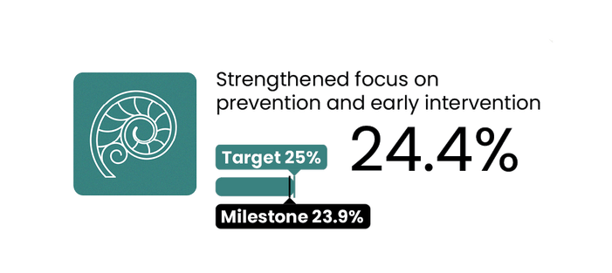
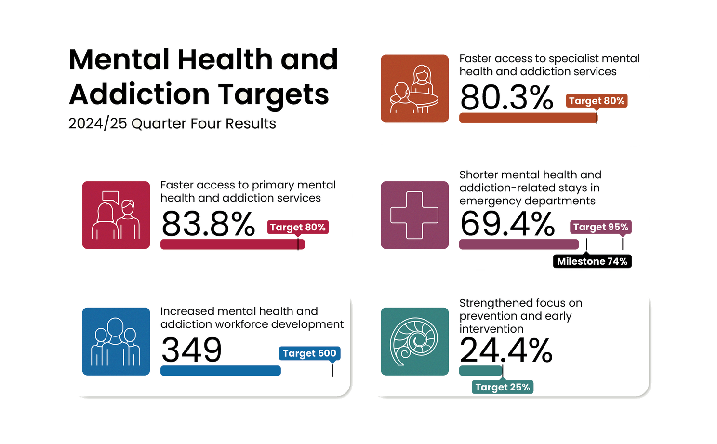
Increased mental health and addiction workforce development
Strengthened focus on prevention and early intervention
Target = 500 more trained yearly
2030 target = 25%
National result (Semester 1 2025)
National result
This measure shows the number of mental health and addiction professionals trained each year in New Zealand.
This measure presents the proportion of mental health and addiction ringfenced investment allocated to prevention and early intervention.
Q1 overview
Q1 overview
A total of 349 people in the identified professions commenced training in semester one of the 2025 academic year.
This is a partial result, as it represents only the first semester intake.
Some professions have a second semester intake (starting in the middle of the calendar year).
Results for the second semester will not be available until quarter two 2025/26, at which point we will report the full year result for the 2025 calendar year
This result is the annual budgeted investment; it does not represent the proportion of the mental health and addiction ringfence that has been spent during the quarter.
The “Top Up” mental wellbeing promotion campaign was launched and rolled out across television, radio, digital, display and social media channels. Early engagement data indicates a strong audience interaction. Over the coming months the campaign will continue to rollout across a range of media and social platforms.
Applications for Top Up community grants, administered by the Mental Health Foundation, are currently open.
Community grants are intended to support initiatives grounded in the Five Ways to Wellbeing – Connect, Give, Take Notice, Be Active and Keep Learning – creating ripples of wellbeing in communities.
Comparisons to historic data reflects the first published result. Data is based on point-in-time snapshots and may differ from other published statistics due to differences in timing, methodology, or data sources. See caveats.

