Slide 1

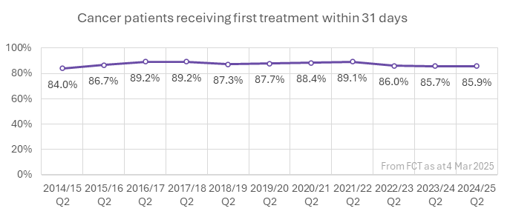

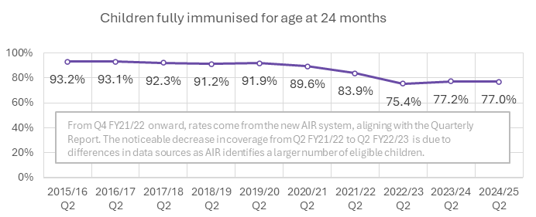

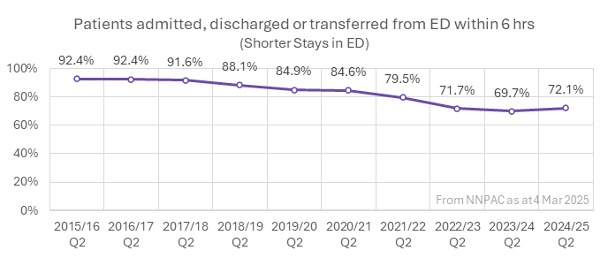

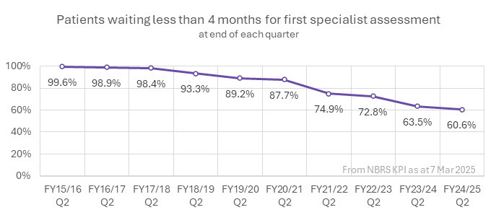

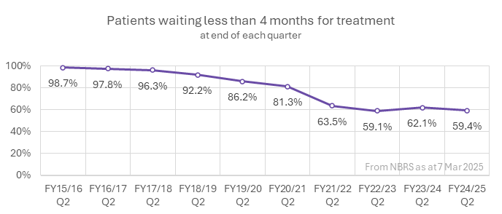

Health Targets 10 years of Q2 (Oct-Dec) results
Reductions in wait time will mean you and your whānau will be guided through complex cancer care pathways to receive treatment sooner.
Treated in Q2 24/25
4,546
Treated within 31d
3,903
Better immunisation coverage will reduce the risk of measles, mumps, rubella and other infectious diseases which can cause harm to your baby.
Eligible babies
Q2 24/25
14,891
Fully immunised
11,462
Reductions in wait
time will mean you
receive diagnosis,
treatment, and
progress through to a
hospital bed (if
needed) sooner.
Seen in ED Q2 24/25
332,110
Seen within
6 hrs
239,519
Reductions in waiting
will mean you are
seen by a hospital
specialist sooner who
will start plans for
your condition.
People waiting end of Q2 24/25
197,179
Waiting
<4 mths
119,439
Reductions in waiting times will mean you receive your
treatment sooner.
People waiting end of Q2 24/25
84,989
Waiting <4 mths
50,283

