Slide 1
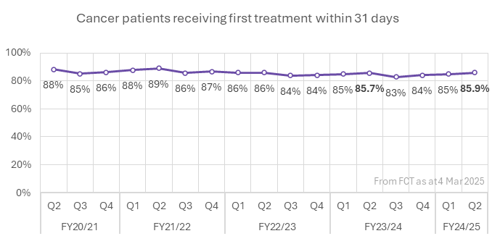

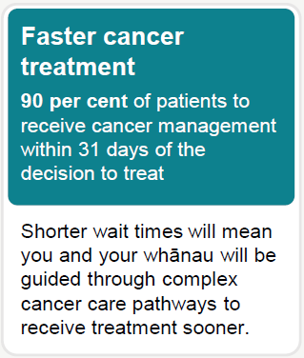
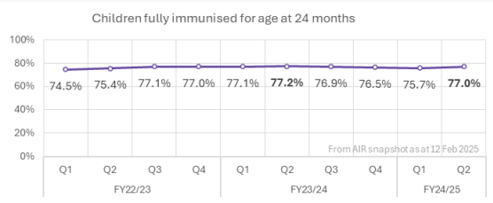

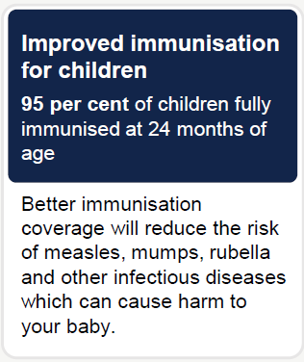
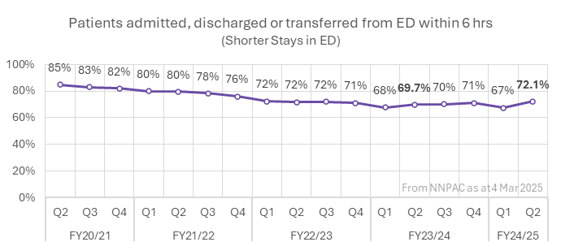

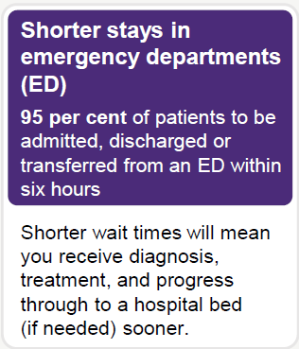
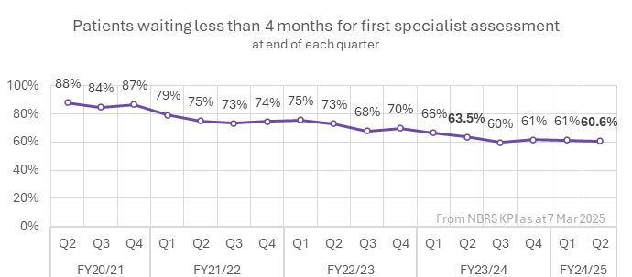

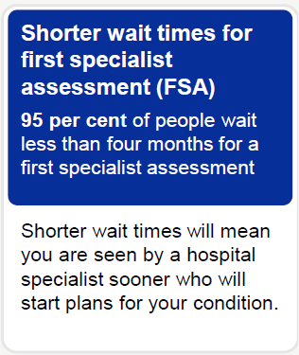
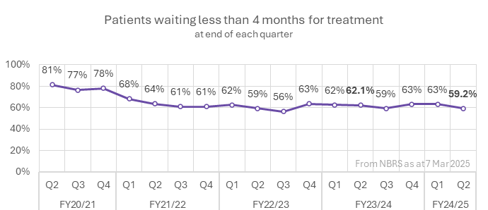

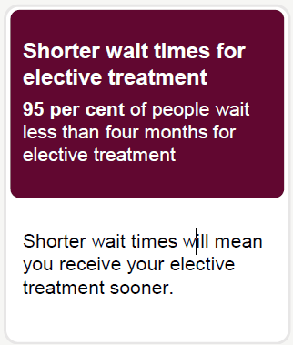
Health Targets to Q1 (Jul-Sep 2024)
Treated in Q2 24/25
4,546
Treated within 31d
3,903
Eligible babies
Q2 24/25
14,891
Better Immunisation coverage will reduce the risk of measles, pertussis (whooping cough), pneumonia, meningitis and other infectious diseases which can cause harm to your baby.
Fully immunised
11,462
Seen in ED Q2 24/25
332,110
Seen within
6 hrs
239,519
People waiting end of Q2 24/25
197,179
Waiting
<4 mths
119,439
People waiting end of Q2 24/25
84,989
Waiting <4 mths
50,283
Results rounded to nearest whole number apart from this quarter for legibility.

