Slide 1

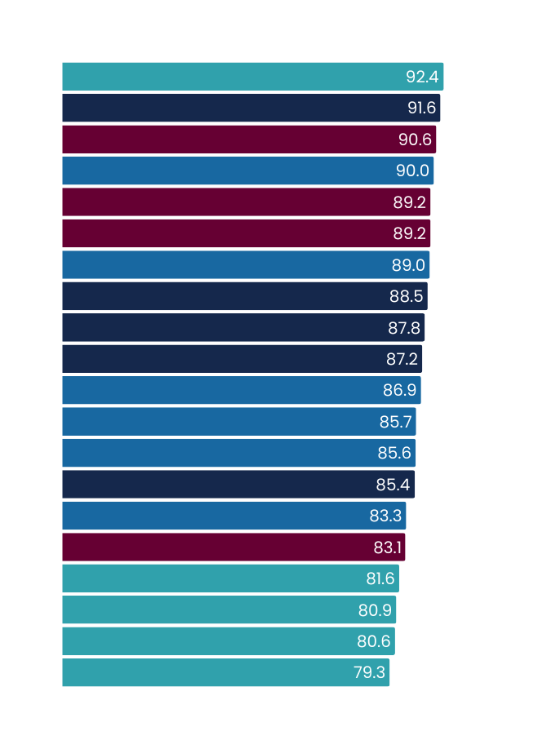
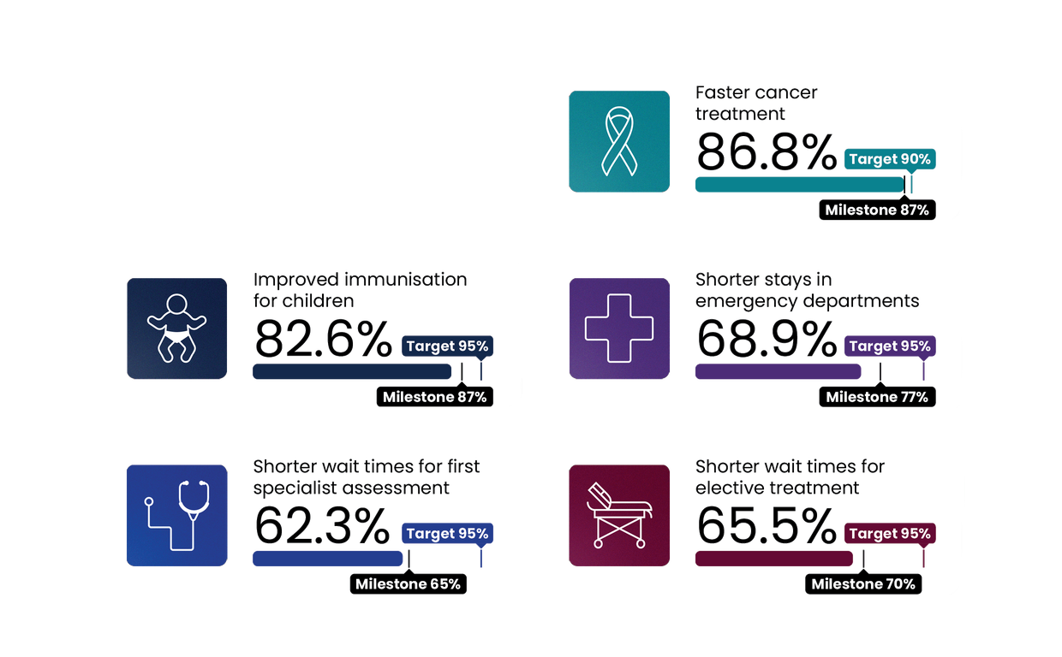
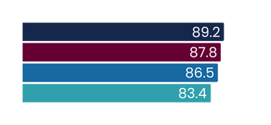
Faster cancer treatment
2025/26 milestone = 87% | 2030 target = 90%
Q1 2025/26
July - September 2025
This measure shows the proportion of eligible cancer patients who received their first treatment within 31 days of a health professional’s decision to treat.
National result
Results by region
Milestone
Target
Results by district
Milestone
Target
Te Manawa Taki
Northern
Central | Te Ikaroa
Te Waipounamu
Nelson Marlborough
Waikato
Waitematā
MidCentral
Northland
Auckland
Wairarapa
Bay of Plenty
Tairāwhiti
Lakes
Hutt Valley
Whanganui
Hawke’s Bay
Taranaki
Capital and Coast
Counties Manukau
Canterbury
West Coast
Southern
South Canterbury
Milestone - 30 June 2026
Total patients receiving first cancer treatment
Treated in Q1 2024/25
Treated in Q1 2025/26
4,548
4,777
Q1 results compared with Q1 last year
 | Q1 2024/25 | Q1 2025/26 | % point change
Faster cancer treatment <31 days | 84.6% | 86.8% | 2.2%
Q1 overview
Regional plans to expand infusion capacity under the new cancer medicines initiative are in place, with implementation underway in the Northern region.
Implementation of the faecal immunochemical test (FIT) for the symptomatic pathway is progressing, expanding access to early diagnostic testing. Waikato went live in August, and Hawke’s Bay, Waitematā, Counties Manukau, and Southern are planned for quarter two.
Based on a successful Te Manawa Taki model, Te Waipounamu is developing a regional tracking dashboard to identify patients on day 20 of the 31-day pathway that either do not have a treatment date booked or are booked for a date beyond 31 days, to ensure escalation steps to enable treatment within target timeframes.
Pacific Health Cancer Coordinator nurses across the motu supported culturally responsive engagement with Pacific patients and families. While this contributed to national improvement in access for Pacific Peoples, capacity in high-need areas affected consistency of support.
Milestone - 30 June 2026
All figures displayed are percentages.
Comparisons to historic data reflects the first published result. Data is based on point-in-time snapshots and may differ from other published statistics due to differences in timing, methodology, or data sources. See caveats.

Slide 2
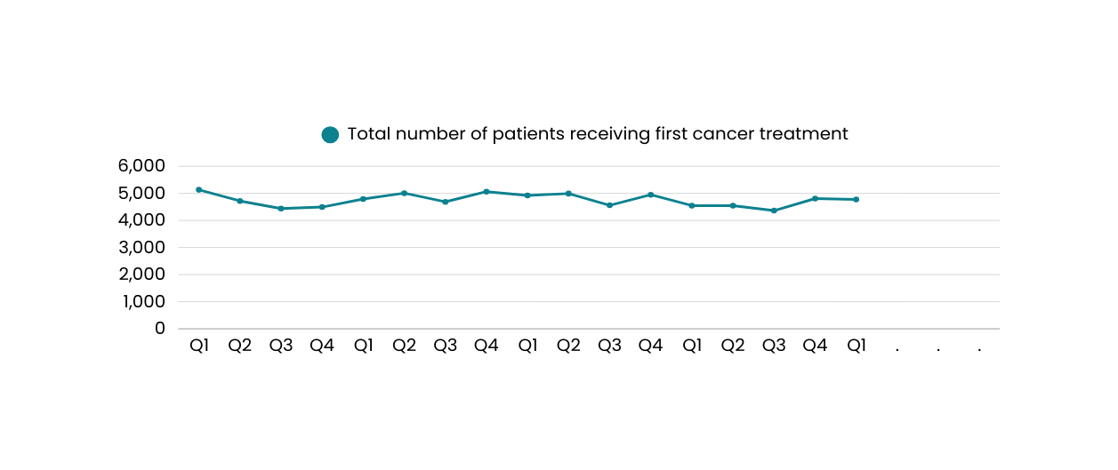
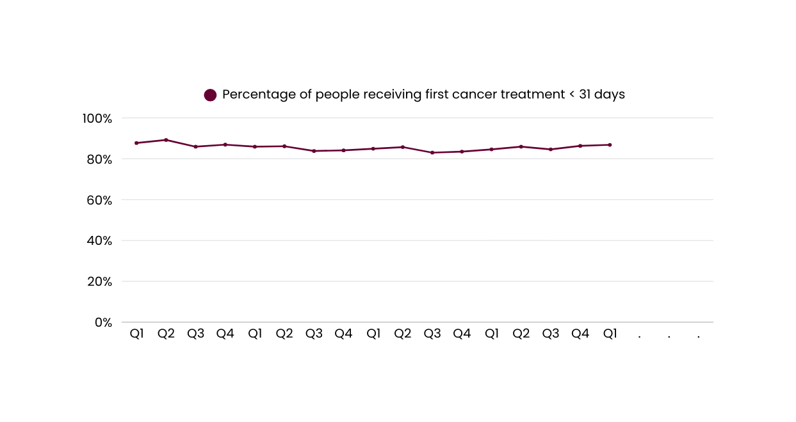
Faster cancer treatment
Number of patients receiving first cancer treatment
4,548
4,777
Q2
Q3
Q4
21/22
22/23
23/24
24/25
25/26
84.6%
86.8%
Q2
Q3
Q4
21/22
22/23
23/24
24/25
25/26
Comparisons to historic data reflects the first published result. Data is based on point-in-time snapshots and may differ from other published statistics due to differences in timing, methodology, or data sources. See caveats.

Slide 3
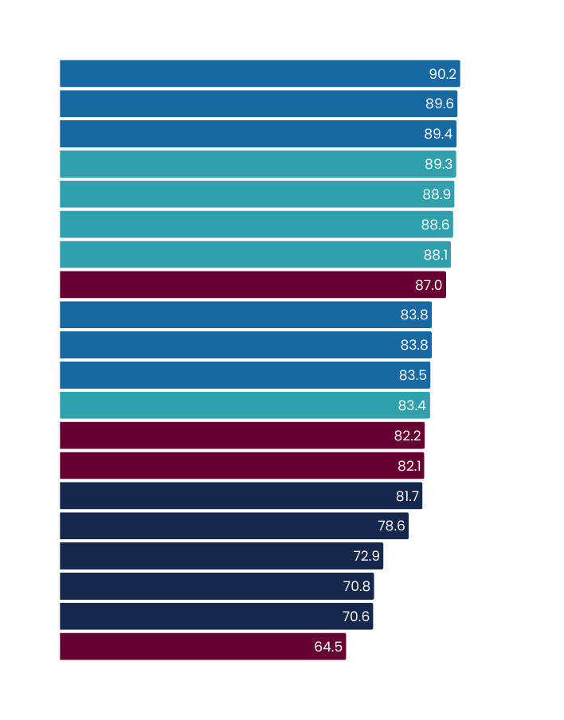
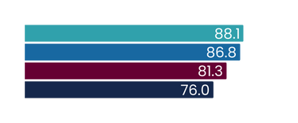
Improved childhood immunisations
2025/26 milestone = 87% | 2030 target = 95%
Q1 2025/26
July - September 2025
This measure shows the percentage of children who have all their scheduled vaccinations by the time they are two years old.
National result
Results by region
Milestone
Target
Results by district
Milestone
Target
Te Waipounamu
Central | Te Ikaroa
Northern
Te Manawa Taki
Capital and Coast
Hutt Valley
Wairarapa
West Coast
Canterbury
Southern
South Canterbury
Auckland
Whanganui
MidCentral
Hawke’s Bay
Nelson Marlborough
Waitematā
Counties Manukau
Taranaki
Waikato
Bay of Plenty
Tairāwhiti
Lakes
Northland
Milestone - 30 June 2026
Number of children fully immunised at 24 months
Q1 2024/25
Q1 2025/26
11,642
11,967
Q1 results compared with Q1 last year
 | Q1 2024/25 | Q1 2025/26 | % point change
Improved immunisation for children 24mth | 75.7% | 82.6% | 6.9%
Q1 overview
Immunisation coverage continues to improve nationally. While the 2025/26 target has not yet been met, eight of 20 districts have already achieved the 87% milestone for 30 June 2026.This is a marked improvement on Q1 last year, by which time only two districts had met the 2024/25 milestone.
The Lead Maternity Carer antenatal immunisation programme launched in August, with 80 midwives and practices now registered to provide immunisations to pregnant women. This initiative is a key part of the Government’s response to the whooping cough epidemic.
In Northland, a district action plan was launched to address low coverage rates. The plan focuses on system-wide enrolment efforts, follow-up, data sharing, and communication. Additional clinics, including in-home vaccinations, were delivered by Whanau Awhina Plunket (Plunket) in Kaikohe and Whangarei. The Hapaitia Nga Whanau initiative also launched in Kaikohe - a community-led Kaupapa Māori campaign to re-engage whanau in immunisation discussion.
In quarter one, Hauora Māori partners contracted under the Immunising our Tamariki initiative delivered more than 16,000 vaccinations, including at least 9,000 by age 24-months (69 per cent Māori). The initiative supports the delivery of additional vaccinations to close the gap in vaccination rates between Māori and non-Māori. Procurement for an extension of the initiative was completed this quarter.
Milestone - 30 June 2026
All figures displayed are percentages.
Comparisons to historic data reflects the first published result. Data is based on point-in-time snapshots and may differ from other published statistics due to differences in timing, methodology, or data sources. See caveats.

Slide 4
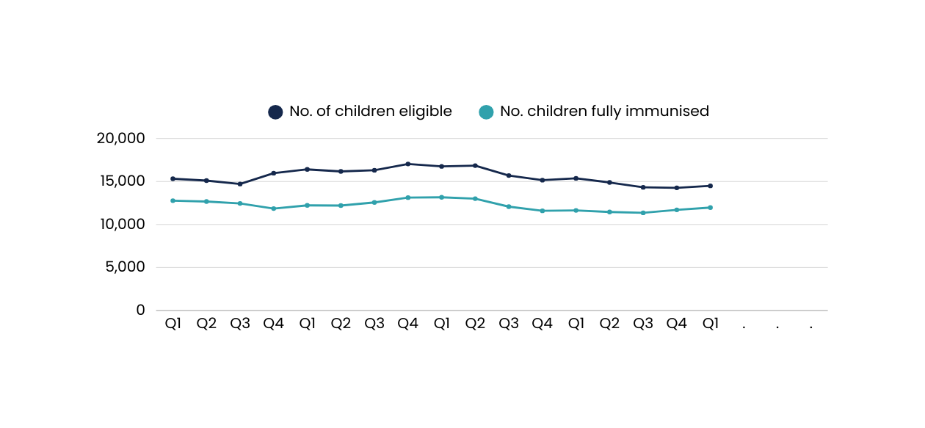
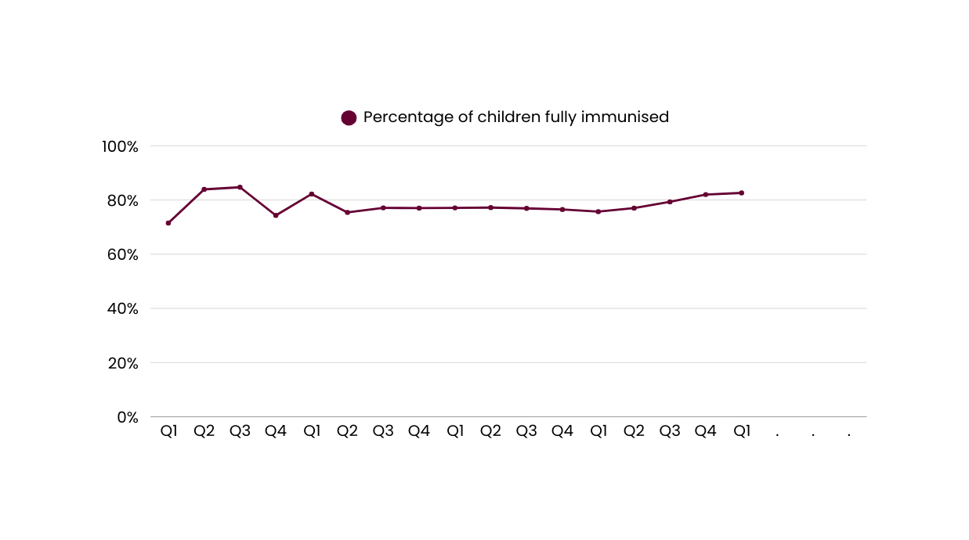
Improved childhood immunisations
Number of children fully immunised
15,373
14,495
11,642
11,967
Q2
Q3
Q4
21/22
22/23
23/24
24/25
25/26
75.7%
82.6%
Q2
Q3
Q4
21/22
22/23
23/24
24/25
25/26
Comparisons to historic data reflects the first published result. Data is based on point-in-time snapshots and may differ from other published statistics due to differences in timing, methodology, or data sources. See caveats.

Slide 5
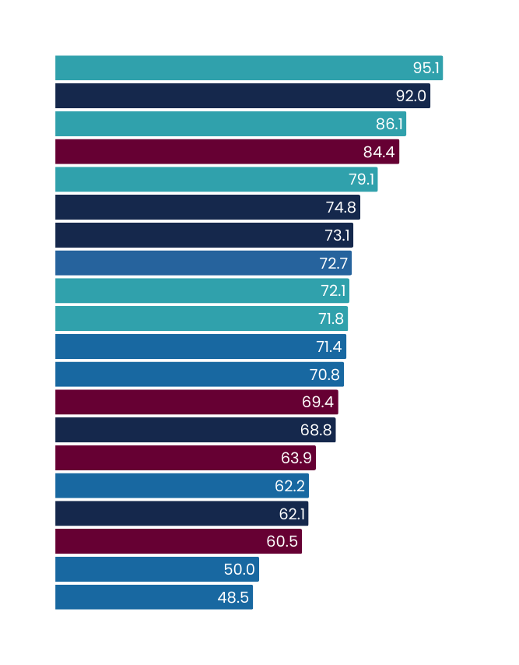
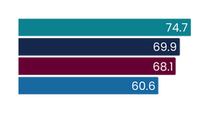
Shorter stays in emergency departments
2025/26 milestone = 77% | 2030 target = 95%
Q1 2025/26
July - September 2025
This measure reports patients admitted, discharged or transferred from an ED within six hours as a percentage of all patients who attended ED.
National result
Results by region
Milestone
Target
Results by district
Milestone
Target
Te Waipounamu
Te Manawa Taki
Northern
Central | Te Ikaroa
West Coast
Tairāwhiti
South Canterbury
Northland
Nelson Marlborough
Lakes
Taranaki
Hawke’s Bay
Canterbury
Southern
Whanganui
Wairarapa
Auckland
Bay of Plenty
Waitematā
Hutt Valley
Waikato
Counties Manukau
Capital and Coast
MidCentral
Milestone - 30 June 2026
Emergency department attendances
Q1 2024/25
Q1 2025/26
336,243
348,598
Q1 results compared with Q1 last year
 | Q1 2024/25 | Q1 2025/26 | % point change
Shorter stays in ED <6hrs | 67.5% | 68.9% | 1.4%
Q1 overview
Despite significantly higher demand, performance this quarter remains higher than the same time last year, resulting in more patients being seen within six hours. We expect a drop in performance every winter due to increased demand, so quarter one’s performance is in line with historical seasonal variance.
We have allocated $20 million in 2025/26 to improve flow through EDs and wards, and to enable improved weekend decision making. Initiatives are being implemented.
West Coast’s strong performance is due to effective communication between ED and ward teams to align patient goals and timely outcomes, alongside increased discharge rates throughout the day and weekends to embed a hospital-wide culture of criteria-led discharge.
Capital and Coast is improving patient flow through recruitment of eight Clinical Nurse Specialists and streamlining discharge processes—particularly on weekends and after-hours—to increase hospital capacity and support timely patient care.
MidCentral partnered with Hato Hone St John Ambulance to provide Practice Plus vouchers for telehealth and after-hours care for patients whose symptoms do not require ED level assessment and treatment; and assigned a paediatric Nurse Practitioner to Palmerston North ED twice weekly to support treatment and timely discharge of children under 15.
We have expanded a successful Hutt Valley High User Project to EDs in Dunedin, Christchurch, Wellington, and Waikato. This involves local Pacific community care providers delivering culturally responsive, wrap-around support to frequent ED users, aiming to reduce repeat visits and improve timely discharge through better connections to appropriate care.
Milestone - 30 June 2026
All figures displayed are percentages.
Comparisons to historic data reflects the first published result. Data is based on point-in-time snapshots and may differ from other published statistics due to differences in timing, methodology, or data sources. See caveats.

Slide 6
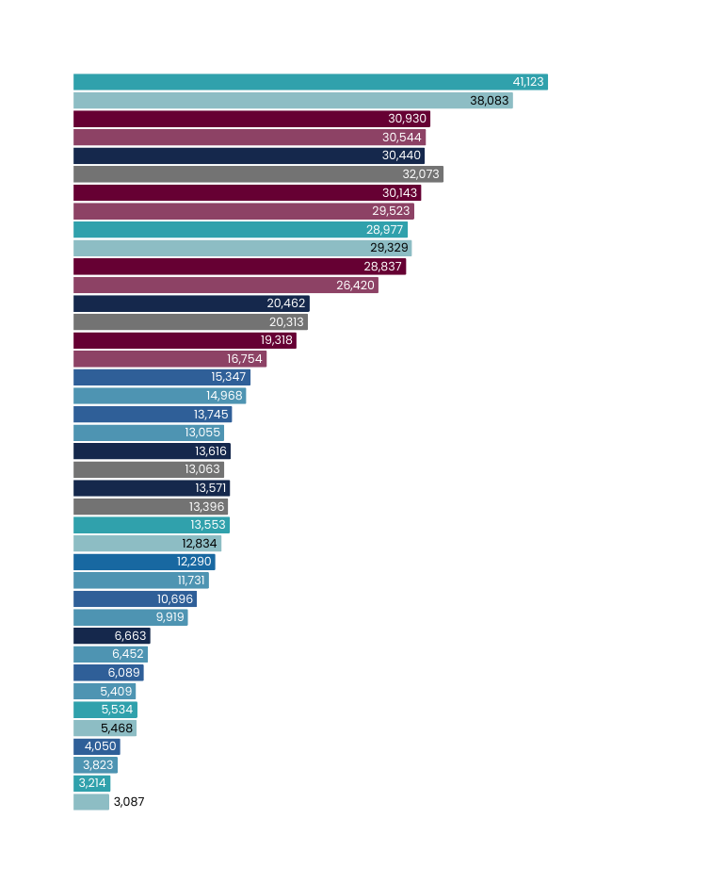
Shorter stays in emergency departments
Number of ED attendances
Q1 2025/26
compared to
Q1 2024/25
Results by district
Canterbury
Counties Manukau
Waikato
Auckland
Southern
Waitematā
Bay of Plenty
Northland
Capital and Coast
Hawke’s Bay
Taranaki
Lakes
Nelson Marlborough
Hutt Valley
MidCentral
Tairāwhiti
Whanganui
South Canterbury
Wairarapa
West Coast
+8.0%
+1.3%
-5.1%
+2.1%
-1.2%
+9.1%
+0.7%
+15.3%
+2.5%
+5.3%
+4.2%
+1.3%
+5.6%
+4.8%
LEGEND
+7.8%
Q1 25/26
+3.3%
Q1 24/25
+12.6%
+1.2%
+5.9%
+4.1%
Comparisons to historic data reflects the first published result. Data is based on point-in-time snapshots and may differ from other published statistics due to differences in timing, methodology, or data sources. See caveats.

Slide 7
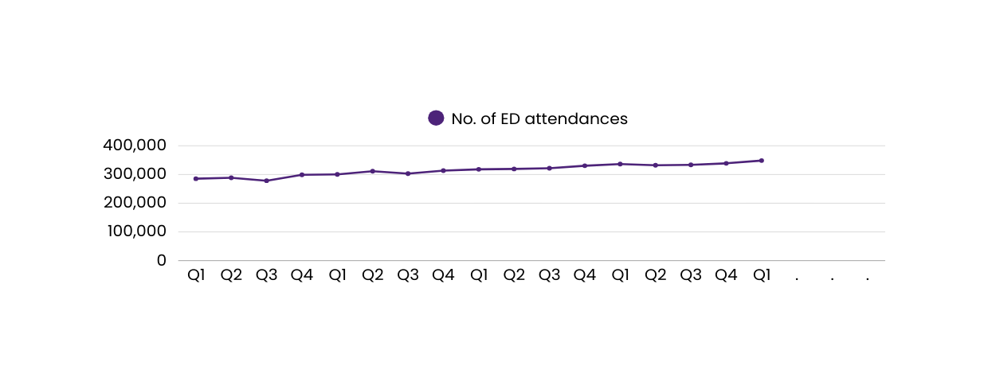
Shorter stays in emergency departments
Number of ED attendances
336,243
348,598
Q2
Q3
Q4
21/22
22/23
23/24
24/25
25/26
Comparisons to historic data reflects the first published result. Data is based on point-in-time snapshots and may differ from other published statistics due to differences in timing, methodology, or data sources. See caveats.

Slide 8
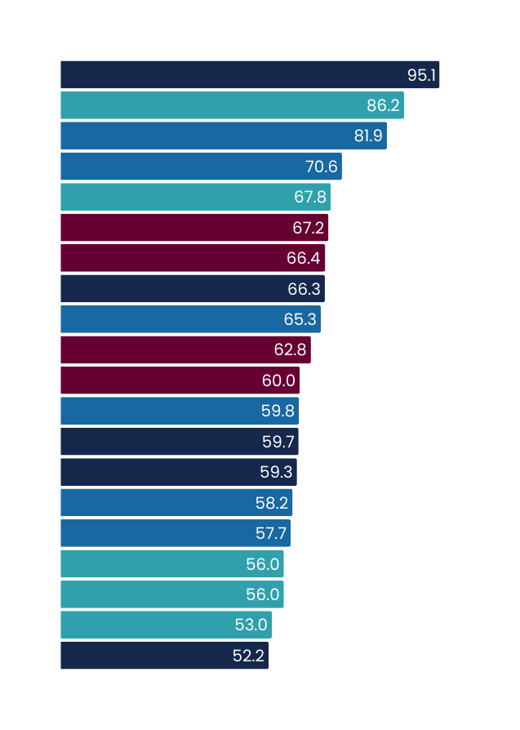
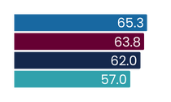
Shorter waits for FSA
2025/26 milestone = 65% | 2030 target = 95%
Q1 2025/26
July - September 2025
This measure shows the proportion of people waiting less than four months for their FSA (first specialist assessment) from the date of referral.
National result
Results by region
Milestone
Target
Results by district
Milestone
Target
Central | Te Ikaroa
Northern
Te Manawa Taki
Te Waipounamu
Lakes
South Canterbury
MidCentral
Whanganui
West Coast
Waitematā
Counties Manukau
Tairāwhiti
Capital and Coast
Northland
Auckland
Wairarapa
Bay of Plenty
Waikato
Hawke’s Bay
Hutt Valley
Southern
Canterbury
Nelson Marlborough
Taranaki
Milestone - 30 June 2026
Total number of first specialist assessments delivered
FSAs delivered
Q1 2024/25
FSAs delivered
Q1 2025/26
188,000
179,651
Q1 results compared with Q1 last year
 | Q1 2024/25 | Q1 2025/26 | % point change
Shorter wait times for FSA | 61.2% | 62.3% | 1.1%
Q1 overview
Performance improved from the same quarter last year, despite services being impacted by five days of industrial action this quarter.
Our national Accelerate Programme launched in September, committing to deliver 800 additional FSA clinics for patients waiting more than 120 days by mid-December 2025.
The musculoskeletal pathway is live in 13 districts (across all regions), triaging non-urgent orthopaedic FSA referrals to physiotherapy-led care to reduce wait times. Full rollout is expected in quarter two.
A clinically led programme has been established to define national standardised approaches for access to planned care, with an initial focus on Ear, Nose and Throat (ENT), Ophthalmology and Orthopaedics. This will support consistent service access and robust performance monitoring across districts. ·Weekly monitoring of long-waiting patients (over 4 months, 1 year, and 700 days) is helping all regions prioritise bookings and reduce waitlist backlogs.
Lakes shared its local FSA standard operating processes with other districts in Te Manawa Taki, to support an uplift in performance. Lakes processes monitor clinics, including appropriateness of patients scheduled and utilisation rates.
Taranaki ran additional clinics with a regional ENT locum, and completed 95% waitlist validation. Boost funding was utilised across Orthopaedics, General Surgery, and Urology, while a Surgical Clinical Nurse Specialist was employed to support follow-up clinics and triage. Operational efficiencies were enhanced by backfilling leave and maintaining ongoing regional engagement to address capacity challenges.
Milestone - 30 June 2026
All figures displayed are percentages.
Comparisons to historic data reflects the first published result. Data is based on point-in-time snapshots and may differ from other published statistics due to differences in timing, methodology, or data sources. See caveats.

Slide 9
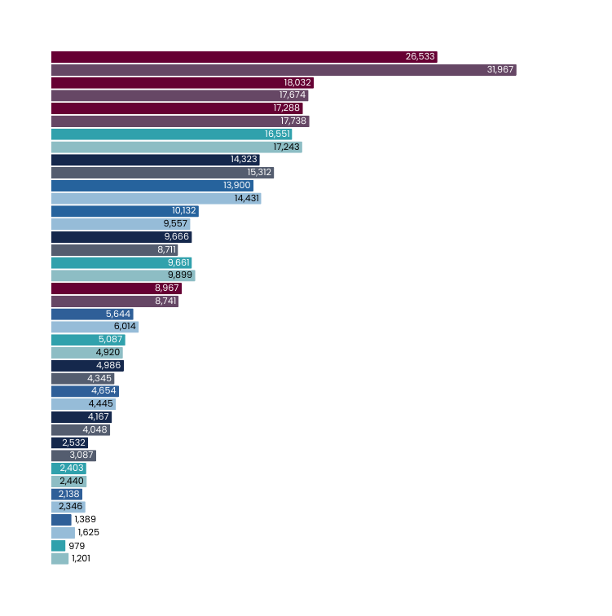
Shorter waits for FSA
Total number of first specialist assessments delivered
Q1 2025/26
compared to
Q1 2024/25
Results by district
Auckland
Waitematā
Counties Manukau
Canterbury
Waikato
Capital and Coast
MidCentral
Bay of Plenty
Southern
Northland
Hawke's Bay
Nelson Marlborough
Taranaki
Hutt Valley
Lakes
Tairāwhiti
South Canterbury
Whanganui
Wairarapa
West Coast
-17.0%
+2.0%
-2.5%
-4.0%
-6.5%
-3.7%
+6.0%
+11.0%
-2.4%
+2.6%
-6.2%
+3.4%
+14.8%
LEGEND
+4.7%
Q1 25/26
+2.9%
Q1 24/25
-18.0%
-1.5%
-8.9%
-14.5%
-18.5%
Comparisons to historic data reflects the first published result. Data is based on point-in-time snapshots and may differ from other published statistics due to differences in timing, methodology, or data sources. See caveats.

Slide 10
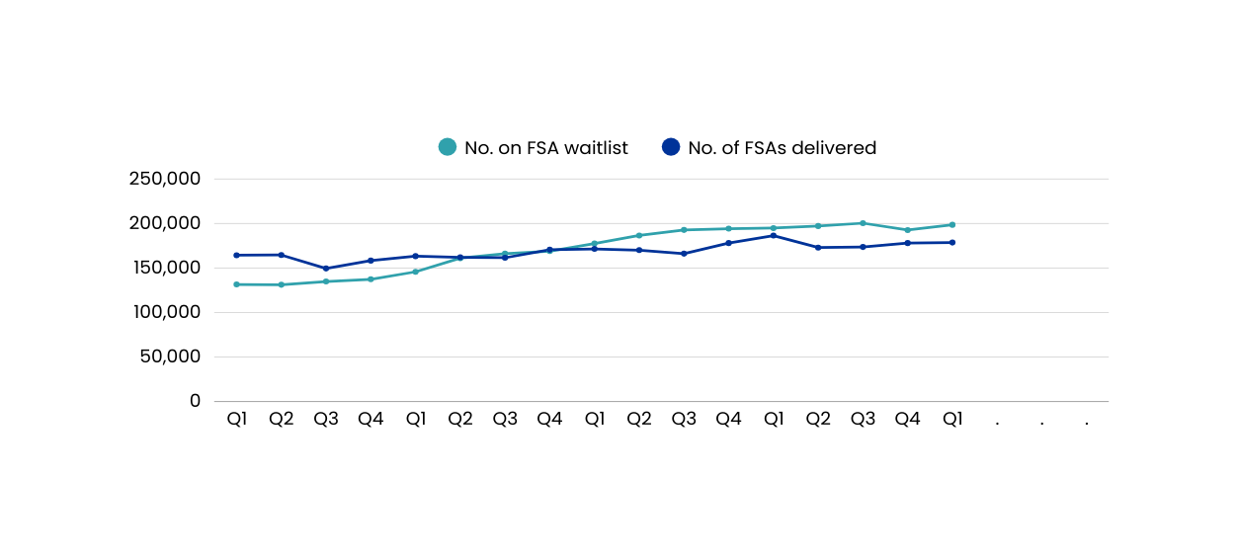
Shorter waits for FSA
Total number of first specialist assessments delivered
Q1 2025/26
compared to
Q1 2024/25
a
194,854
198,577
188,000
179,651
Q2
Q3
Q4
21/22
22/23
23/24
24/25
25/26
*This graph represents the total numbers of FSAs delivered in the quarter, not just those delivered within four months.
Comparisons to historic data reflects the first published result. Data is based on point-in-time snapshots and may differ from other published statistics due to differences in timing, methodology, or data sources. See caveats.

Slide 11
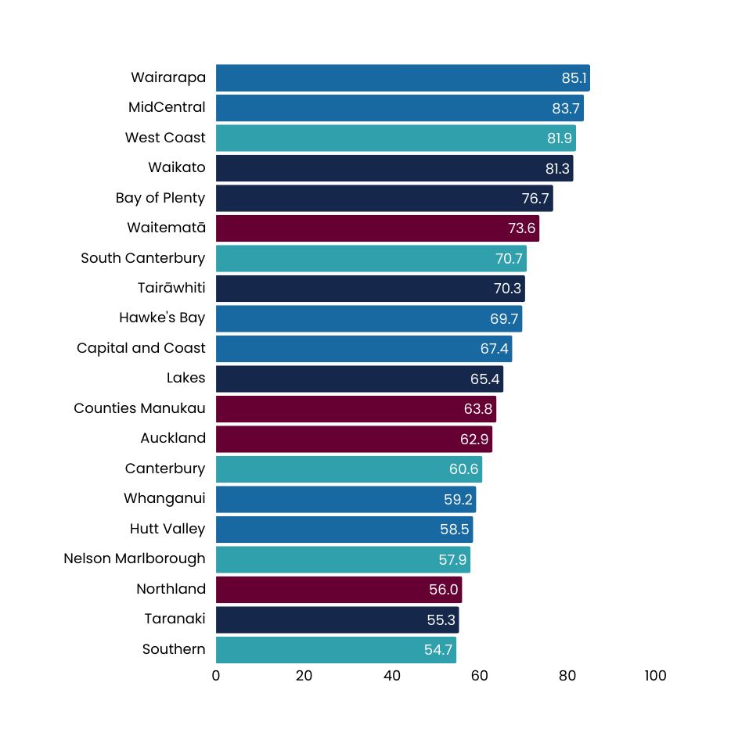
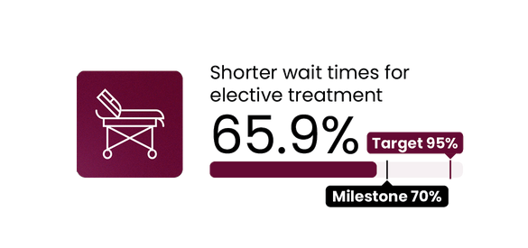
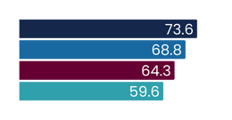
Shorter wait times for elective treatment
2025/26 milestone = 70% | 2030 target = 95%
Q1 2025/26
July - September 2025
This measure shows the proportion of people given a commitment to treatment waiting less than four months, as a proportion of all people waiting for a procedure.
National result
Results by region
Milestone
Target
Results by district
Milestone
Target
Te Manawa Taki
Central | Te Ikaroa
Northern
Te Waipounamu
Milestone - 30 June 2026
Number of people treated from the waitlist
Q1 2024/25
Q1 2025/26
52,892
47,908
Q1 results compared with Q1 last year
 | Q1 2024/25 | Q1 2025/26 | % point change
Shorter wait times for elective treatment | 62.2% | 65.9% | 3.7%
Q1 overview
Performance improved from the same quarter last year, despite service delivery being impacted by five days of industrial action this quarter.
Focus remains on treating long-waiting patients through initiatives like weekly waitlist monitoring, standardised management guidance, and validation processes.
Inpatient and Day Patient Wait List Management Guidelines were implemented nationally, providing a standardised framework for managing treatment wait lists and scheduling.
Integration between primary and secondary care, along with the rural generalist model on the West Coast district has supported high performance. A rural generalist can sustainably manage a broad and varied patient cohort and community need profile, while working within clinical networks of care to ensure patients get access to specialist teams if and when they need them. This has the benefit of reducing the need for patient travel by keeping care delivery local.
MidCentral has established Saturday theatre lists for some specialities with lengthy wait lists, to sustain and improve throughput, utilising available theatre and clinical resource to ensure patients receive timely elective treatment.
Taranaki is focused on improving throughput by outsourcing, enhanced theatre scheduling, a mid-week trauma list to manage acute flow, and full theatre staffing to operate six theatres from January 2026.
Southern is prioritising two key initiatives: addressing long-standing capacity challenges in Urology, Orthopaedics, and Ophthalmology while securing anaesthetist capacity for Southland; and implementing a new weekly Clinical & Operational process to develop individualised plans for the district’s longest-waiting patients.
Milestone - 30 June 2026
All figures displayed are percentages.
Comparisons to historic data reflects the first published result. Data is based on point-in-time snapshots from the National Collections National Booking Reporting System (unless otherwise stated), and may differ from other published statistics due to differences in timing, methodology, or data sources. See caveats.

Slide 12
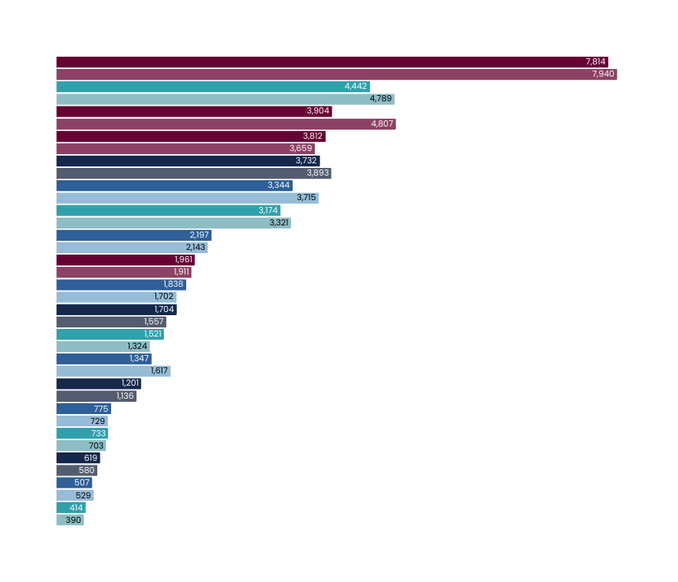
Shorter wait times for elective treatment
Number of people treated from the waitlist
Q1 2025/26
compared to
Q1 2024/25
Results by district
Auckland
Canterbury
Waitematā
Counties Manukau
Bay of Plenty
Capital and Coast
Southern
MidCentral
Northland
Hawke’s Bay
Lakes
Nelson Marlborough
Hutt Valley
Taranaki
Whanganui
South Canterbury
Tairāwhiti
Wairarapa
West Coast
-1.6%
-7.2%
-18.8%
Waitematā caveat: There is a drop in volume as GP skin lesion procedures are no longer included in the inpatient waitlist, but were included in Q1 24/25.
4.2%
-4.1%
-10.0%
-4.4%
+2.5%
+2.6%
+8.0%
+9.4%
+14.9%
-16.7%
+5.7%
+6.3%
+4.3%
+6.7%
LEGEND
-4.2%
Q1 25/26
+6.2%
Q1 24/25
Caveat: Waikato volumes are withheld from this graph. A system update data issue means that closures from the waitlist are incomplete and not an accurate representation of actual delivery. Waikato is not excluded from any other result for the elective treatment target.
Comparisons to historic data reflects the first published result. Data is based on point-in-time snapshots and may differ from other published statistics due to differences in timing, methodology, or data sources. See caveats.

Slide 13
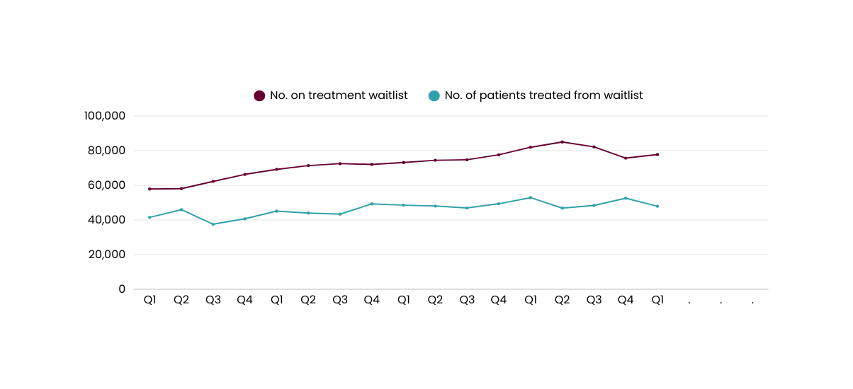
-1.6%
Shorter wait times for elective treatment
Number of people treated from the waitlist
81,973
77,764
52,892
47,908
Q2
Q3
Q4
21/22
22/23
23/24
24/25
25/26
Comparisons to historic data reflects the first published result. Data is based on point-in-time snapshots and may differ from other published statistics due to differences in timing, methodology, or data sources. See caveats.

