Slide 1

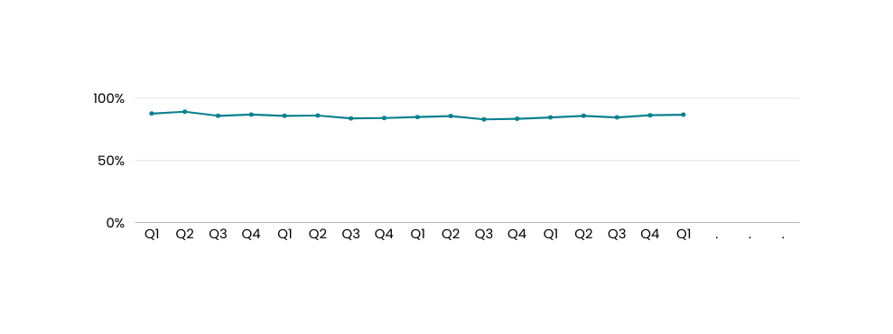
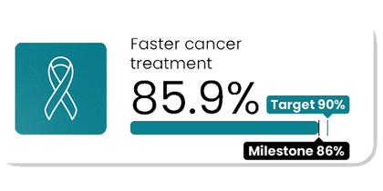
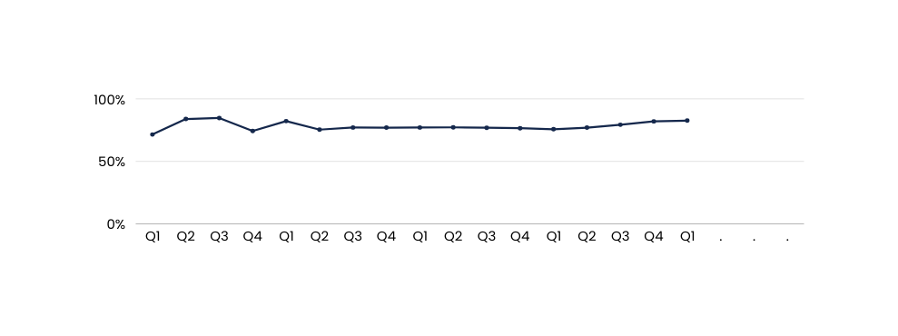
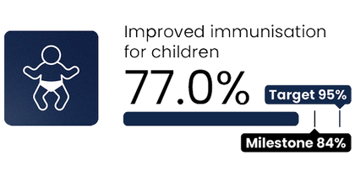
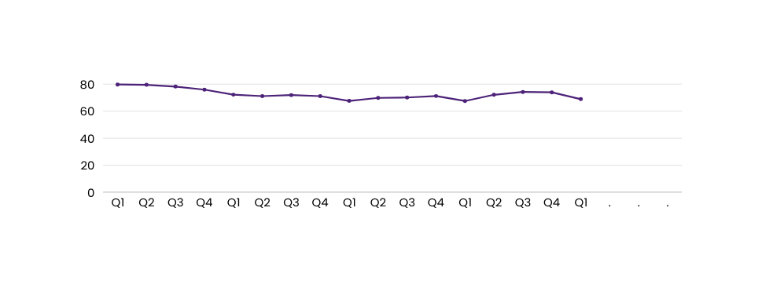
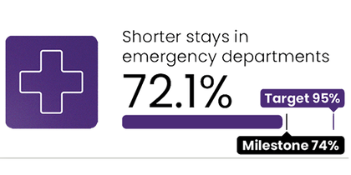
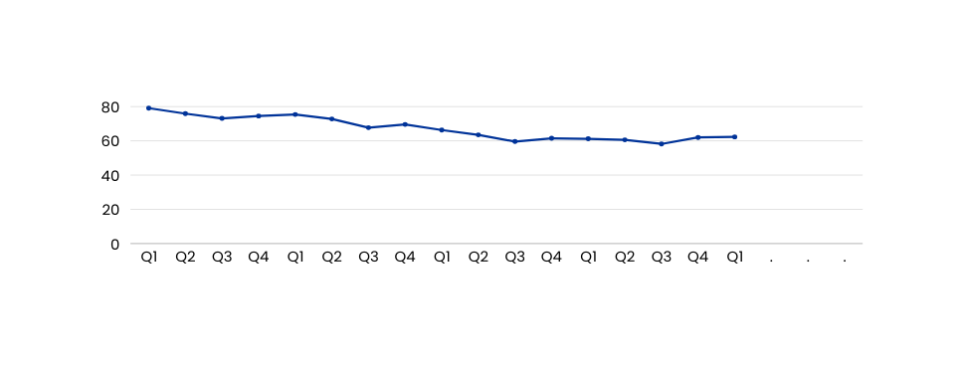
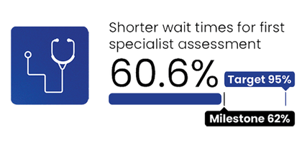
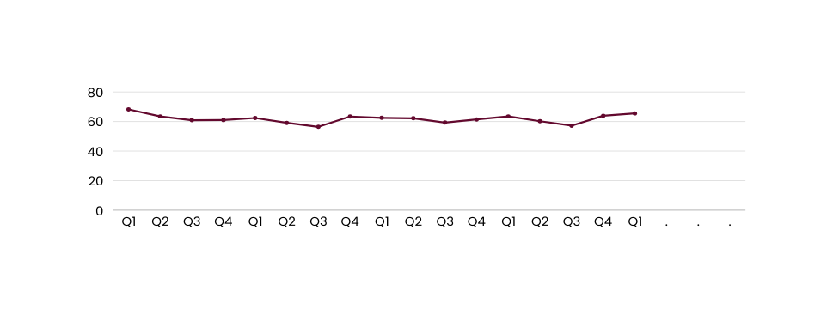
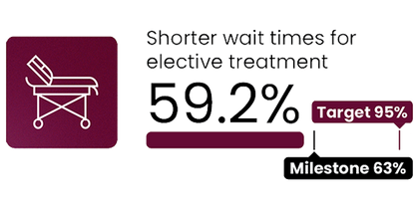
Health Targets
2025/26 Quarter 1 Last 5 Years
Faster cancer treatment <31 days
2025/26 milestone: 87%
2030 target: 90% of patients to receive cancer treatment within 31 days of the decision to treat
87.7%
85.9%
84.9%
84.6%
86.8%
No. of patients receiving 1st treatment Q1 25/26
Shorter wait times will mean you and your whānau will be guided through complex cancer pathways to receive treatment sooner.
4,777
Q2
Q3
Q4
No. of patients receiving 1st treatment Q1 24/25
21/22
22/23
23/24
24/25
25/26
4,548
Improved immunisation for children <24 months
2025/26 milestone: 87%
2030 target: 95% of children fully immunised at 24 months of age
71.5%
82.2%
77.1%
75.7%
82.6%
Better immunisation coverage will reduce the risk of measles, pertussis (whooping cough), pneumonia, meningitis and other infectious diseases which can cause harm to children.
Children immunised in Q1 25/26
11,967
Q2
Q3
Q4
Children immunised in Q1 24/25
21/22
22/23
23/24
24/25
25/26
11,642
Shorter stays in ED
2025/26 milestone: 77%
2030 target: 95% of patients to be admitted, discharged or transferred from an ED within 6 hours
79.7%
72.2%
67.5%
67.5%
68.9%
Shorter wait times will mean you receive your diagnosis, treatment, and progress through to a hospital bed (if needed) sooner.
Seen in ED Q1 25/26
348,598
Q2
Q3
Q4
Seen in ED Q1 24/25
21/22
22/23
23/24
24/25
25/26
336,243
Shorter wait times for FSA
2025/26 milestone: 65%
2030 target: 95% of people wait less than four months for a first specialist assessment
79.1%
75.4%
66.3%
61.2%
62.3%
People waiting
Q1 25/26
Shorter wait times will mean you are seen by a hospital specialist sooner who will start plans for your condition.
198,577
Q2
Q3
Q4
People waiting
Q1 24/25
21/22
22/23
23/24
24/25
25/26
194,854
Shorter wait times for elective treatment
2025/26 milestone: 70%
2030 target: 95% of people wait less than four months for elective treatment
68.2%
62.4%
62.1%
62.2%
65.9%
People waiting
Q1 25/26
Shorter wait times will mean you receive your elective treatment sooner.
77,764
22/23
23/24
24/25
Q2
Q3
Q4
People waiting
Q1 24/25
21/22
25/26
81,973
Comparisons to historic data reflects the first published result. Data is based on point-in-time snapshots and may differ from other published statistics due to differences in timing, methodology, or data sources. See caveats.

Slide 2
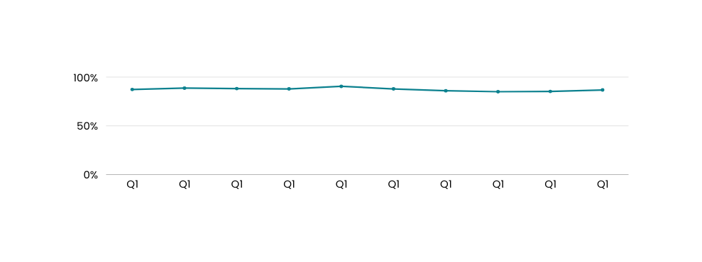
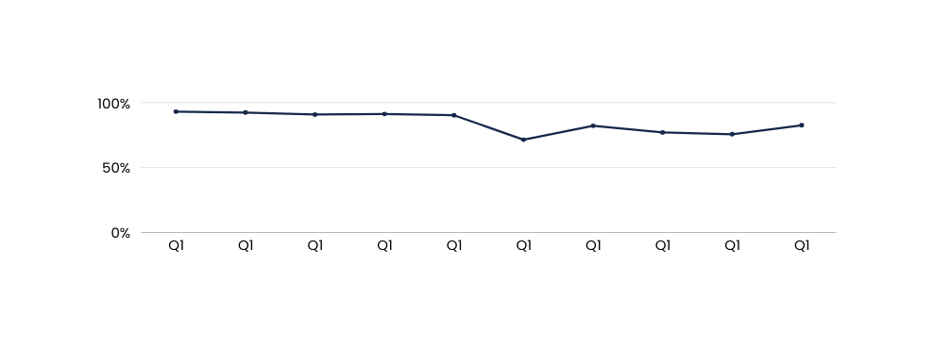
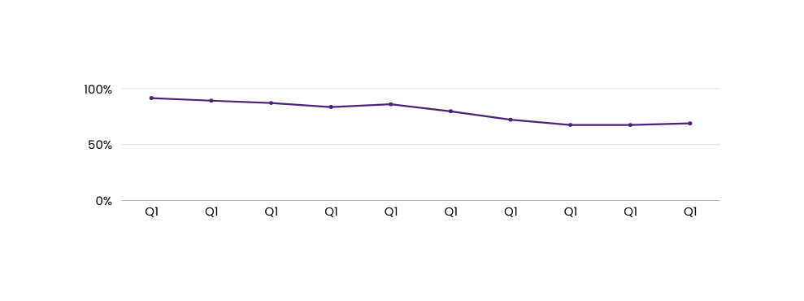
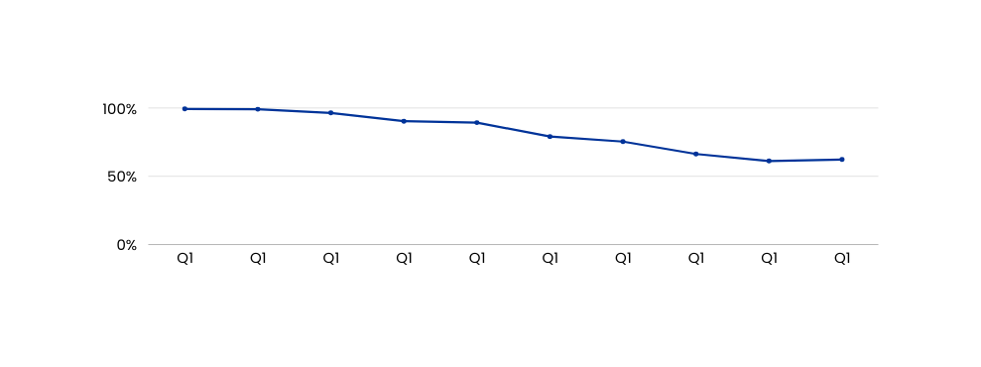
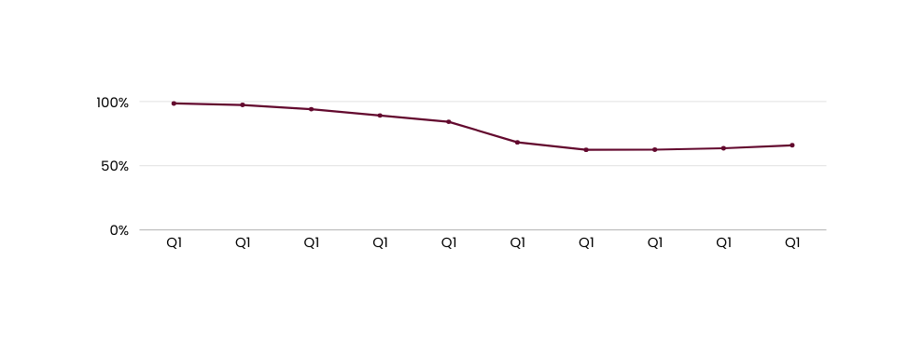
Health Targets
2025/26 Quarter 1 Last 10 Years
Faster cancer treatment <31 days
2025/26 milestone: 87%
2030 target: 90%
Reductions in wait time will mean you and your whānau will be guided through complex cancer care pathways to receive treaments sooner.
87.1%
88.6%
88.0%
87.7%
90.3%
87.7%
85.9%
84.9%
84.6%
86.8%
No. of patients receiving 1st treatment Q1 25/26
4,777
No. of patients receiving 1st treatment Q1 24/25
16/17
17/18
18/19
19/20
20/21
21/22
22/23
23/24
24/25
25/26
4,548
Improved immunisation for children <24 months
2025/26 milestone: 87%
2030 target: 95%
Better immunisation coverage will reduce the risk of measles, mumps, rubella and other infectious diseases which can cause harm to children.
93.1%
92.4%
90.9%
91.3%
90.3%
71.5%
82.2%
77.1%
75.7%
82.6%
Children immunised in Q1 25/26
11,967
Children immunised in Q1 24/25
16/17
17/18
18/19
19/20
20/21
21/22
22/23
23/24
24/25
25/26
11,642
Shorter stays in ED
2025/26 milestone: 77%
2030 target: 95%
Reductions in wait time will mean you receive diagnosis, treatment, and progress through to a hospital bed (if needed) sooner.
91.5%
89.2%
87.1%
83.5%
86.0%
79.7%
72.2%
67.5%
67.5%
68.9%
Seen in ED Q1 25/26
348,598
Seen in ED Q1 24/25
16/17
17/18
18/19
19/20
20/21
21/22
22/23
23/24
24/25
25/26
336,243
Shorter wait times for FSA
2025/26 milestone: 65%
2030 target: 95%
99.3%
99.1%
96.4%
90.3%
89.3%
Reductions in waiting will mean you are seen by a hospital specialist sooner who will start plans for your condition.
79.1%
75.4%
66.3%
61.2%
62.3%
People waiting
Q1 25/26
198,577
People waiting
Q1 24/25
16/17
17/18
18/19
19/20
20/21
21/22
22/23
23/24
24/25
25/26
194,854
Shorter wait times for elective treatment
2025/26 milestone: 70%
2030 target: 95%
98.5%
97.3%
94.0%
89.1%
84.3%
Reductions in waiting times will mean you receive your treatment sooner.
68.2%
62.4%
62.1%
62.2%
65.9%
People waiting
Q1 25/26
77,764
16/17
17/18
18/19
19/20
20/21
21/22
22/23
23/24
24/25
25/26
People waiting
Q1 24/25
81,973
Comparisons to historic data reflects the first published result. Data is based on point-in-time snapshots and may differ from other published statistics due to differences in timing, methodology, or data sources. See caveats.

